Slide 1
Health-RI
Break out Session A1:
Status and Experience with the Core Schema
FAIR TEAM

Slide 2
Goal of cocreation break out session
We want to discuss the current version of Core Metadata Schema
Engaging with Node Experiences
Understand nodes' adoption and implementation of core metadata schemas in a short presentation
Share the evaluation form with the nodes
What are your session’s expectations (https://www.menti.com/al9jq14zq8kd, or go to menti.com and use the access code: 6350 6363)

Slide 3
Agenda (10:30 to 12:30)
Progress Report on Metadata Schema (Timing: 10:30 AM to 11:00 AM)
Speaker: Presentation by the FAIR Working Group
Updates on Metadata Model implementation, usability and extension (timing: 11:00 AM to 11:45 AM)Overview: Presentations from Four Nodes/Working Groups
Presentation 1: Groningen MC - Biobanks and Collections (10 minutes, challenges of adoption) by Rene
Presentation 2, 3: Radboud MC - PRISMA and VASCA (10 minutes,) by Alex
Presentation 4: Erasmus MC – Imaging Working Group (10 minutes, Domain-Specific Requirements) by Alexander
Presentation 5: VU MC (10 minutes, ABC Model) by Joost Daams
Break (15 minutes)
Feedback, evaluation form, next steps, discussion (11:45 to 12:30)
Moderator: Hub by FAIR team
Notes:
ntro to the model, processes, usecase scenarios, feedback and extension on the model (connection to confluence pages, git)
Connection to working groups and cocreation session
Next steps and timeline (Plateau 2) --> link to description

Slide 4
Status update of the metadata schema
(presentation by Hub: 20 -30 minutes)

Slide 5
What is Core Metadata Model?
A core metadata model is a blueprint for describing and searching research resources (e.g., datasets) with required semantics in a standardized way.
It is built on W3C’ standards including DCAT and heavily reuses DCAT Application Profile

Slide 6
RDF vocabularies reused in Core module
DCAT: The base structure of DCAT is made up of several building blocks (classes) that define which broad aspect of data is being described, for example:
DCAT-AP: DCAT-AP specifies how DCAT is to be applied when describing metadata of public sector datasets in Europe. --> [this is the constrain model on top of dcat]
SKOS: for defining taxonomies and controlled vocabularies
FOAF: for defining organizations and people

Slide 7
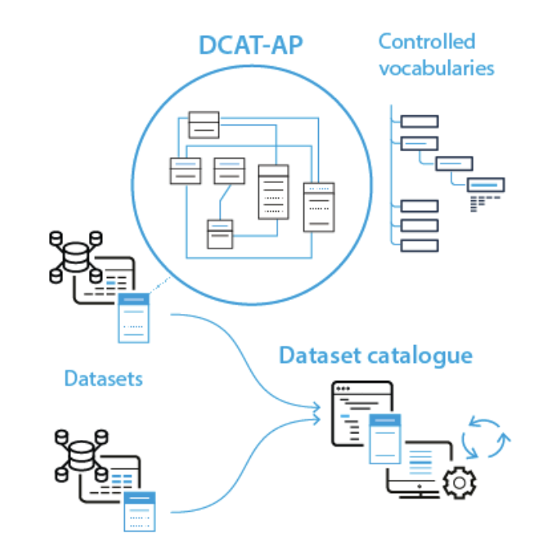
DCAT-AP allows for data linking
dcat-ap allows local dataset to be linked to target catalogue(s) and the use of cv allows different datasets to be linked regardless of the platform used.
Reference
Notes:
THINK OF A NARRATIVE OF USING HEALTH-RI CATALOGUE AND HOW IT LINKS TO THE EU CAT

Slide 8
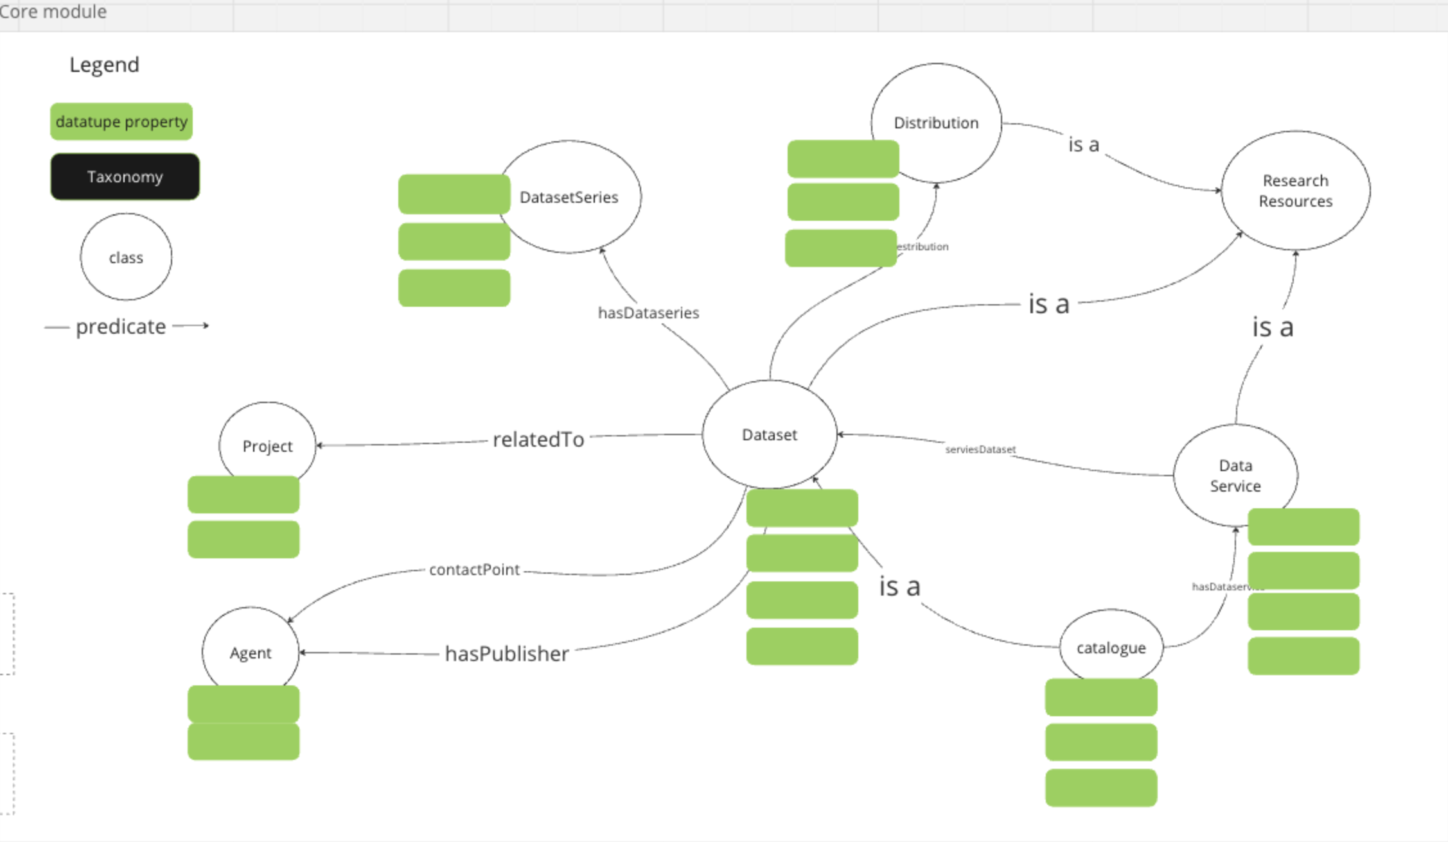
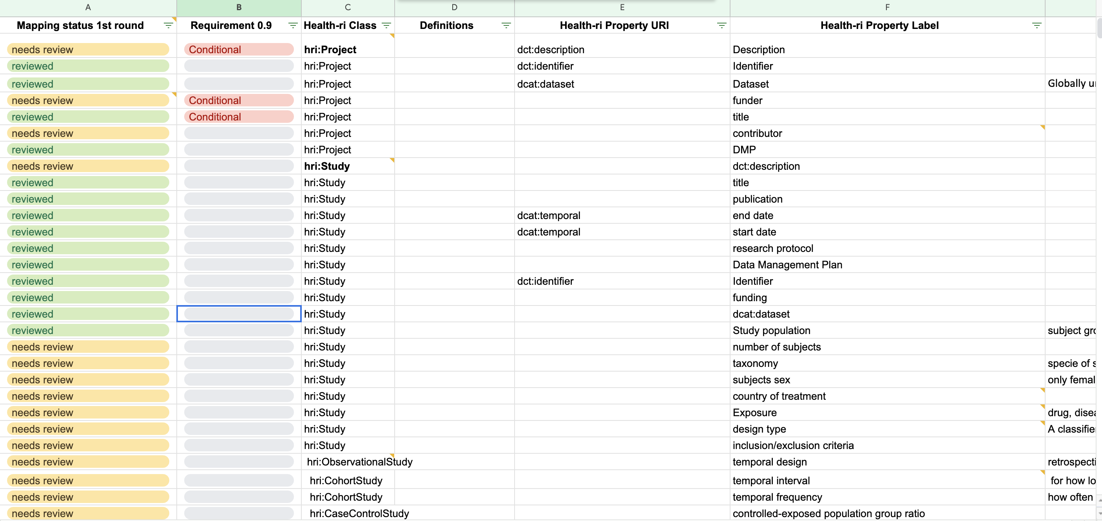
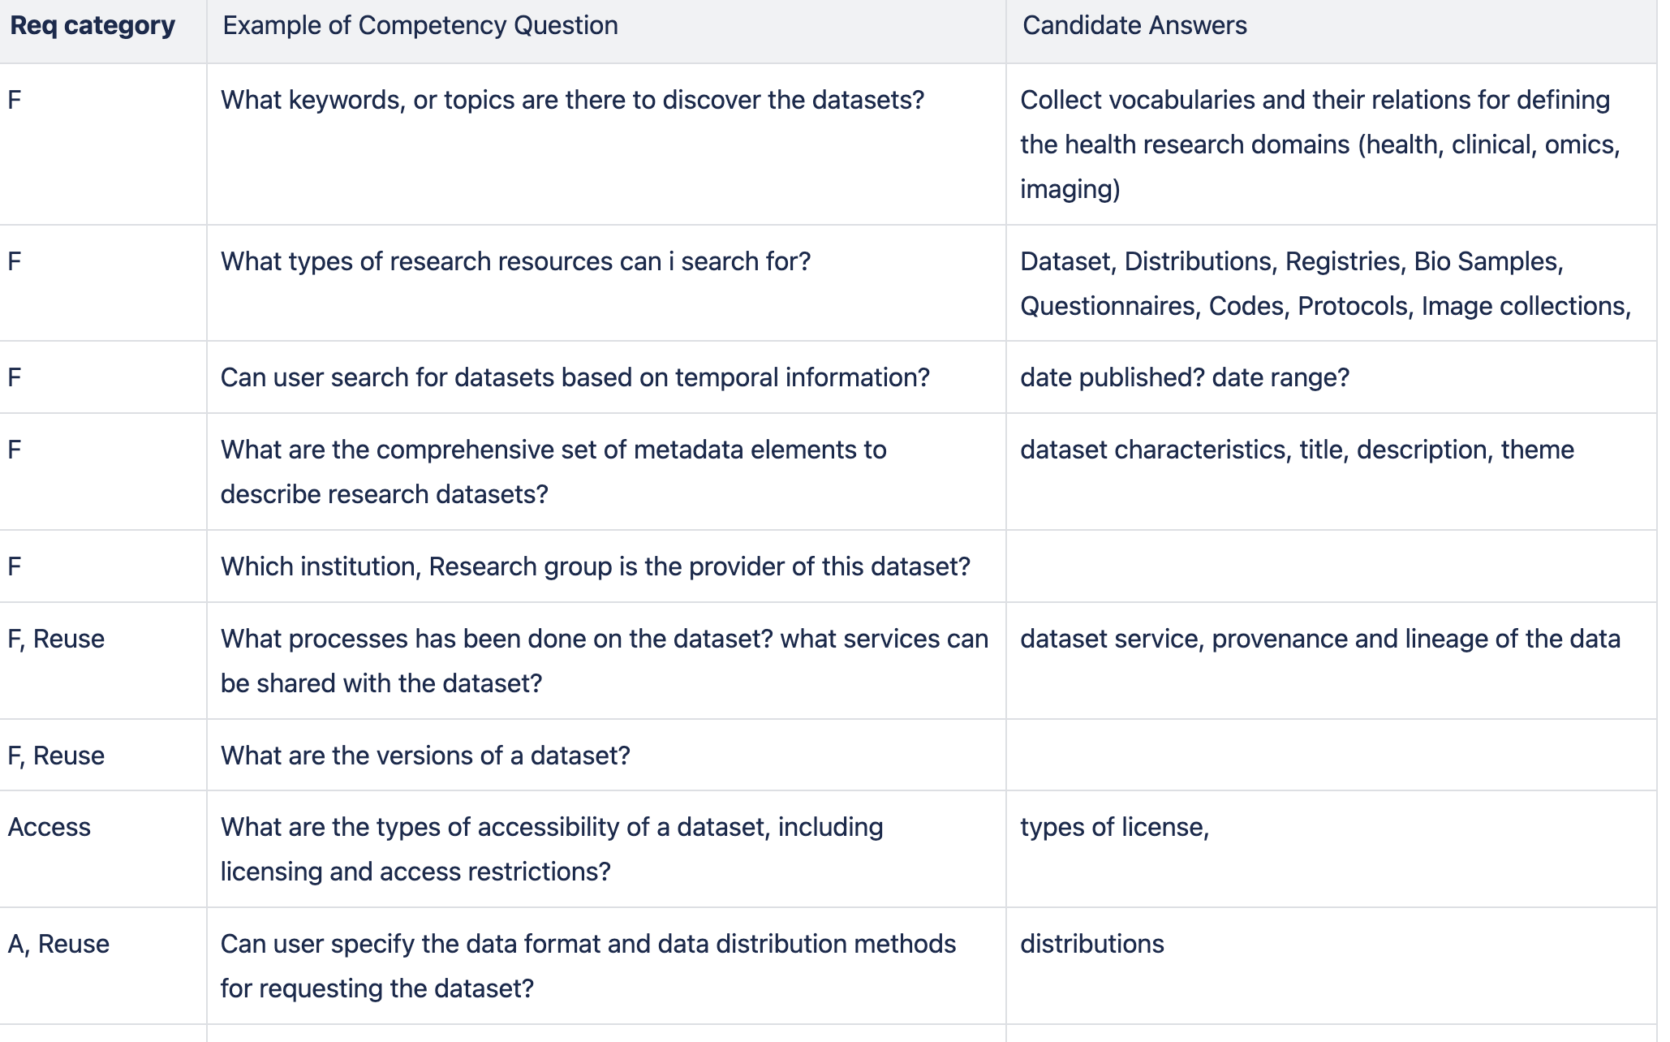
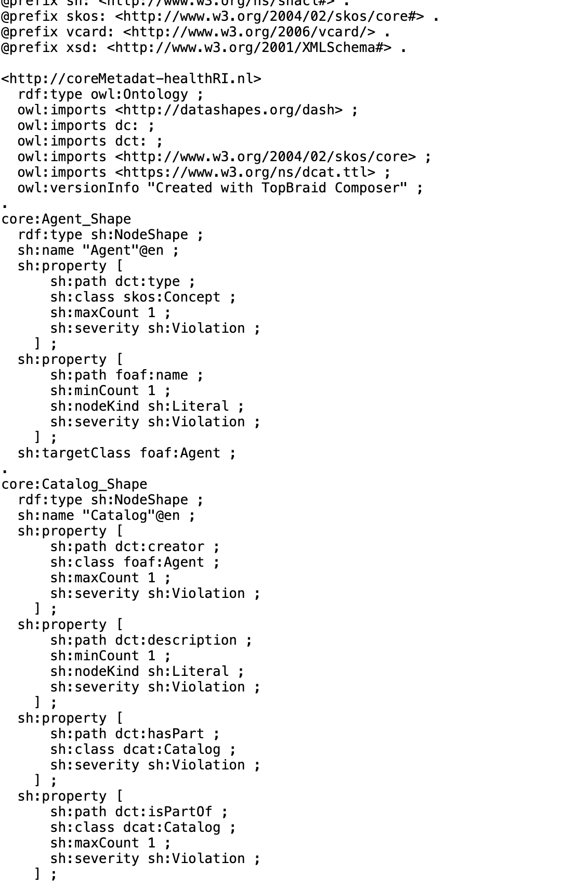

An iterative Process [Animation to be added]
Requirements
Inventory of terminologies
Conceptualisation
Reuse existing standards
formalisation
Evaluation
Notes:
Needs more work

Slide 9
Artefacts
Requirements
link
Inventory of terminologies and definitions (spreadsheet)
lin
Conceptualization (class diagram)
link
Formalization (OWL, SKOS, shacl)
link
Specification (Confluence)
link
Evaluation Forms
In progress

Slide 10
Reusing constraint in dcat-ap: Mandatory elements
Classes
Research Resource, Dataset, Agent, Distribution, Catalogue
Properties:
Catalogue: title, description, publisher, dataset
Dataset: title, description
Distribution: access URL
These mandatory elements are very basic set of descriptors that every system should be able to support - but their functionality is limited

Slide 11
Reusing constraint in dcat-ap: Recommended/Optional elements
Classes
Distribution, Dataset Series, Data Service, Project
Some properties
Distribution,
Dataset Series,
Data Service,
Project
These elements allow for more advanced functionality, e.g. filtering on themes, languages or publisher and should be provided if (at all) possible

Slide 12
Controlled vocabularies (in skos)
CV provide a common set of values for the characteristics and thereby increase interoperability
Example:
classification of datasets according to common "theme" vocabulary
DCAT-AP requires use of several EU vocabularies, e.g. Language, File type, and so on
Challenges:
Collecting local vocabularies for our own
Mapping local vocabularies to common one
Semantic are different
Data Theme
Data type

Slide 13
Metadata in action
Data:

Slide 14
Application areas
Enrichment of the metadata schemas at source (rich semantics)
Integration of resources to the open data portal (aligned, contracted semantics)
Catalogue functionalities:
Search, Discover and Request the health resources on open data portal. (taxonomies, controlled vocabularies)
Notes:
Can we have a reference to the architecture and make it bold where the semantic layer sits?

Slide 15
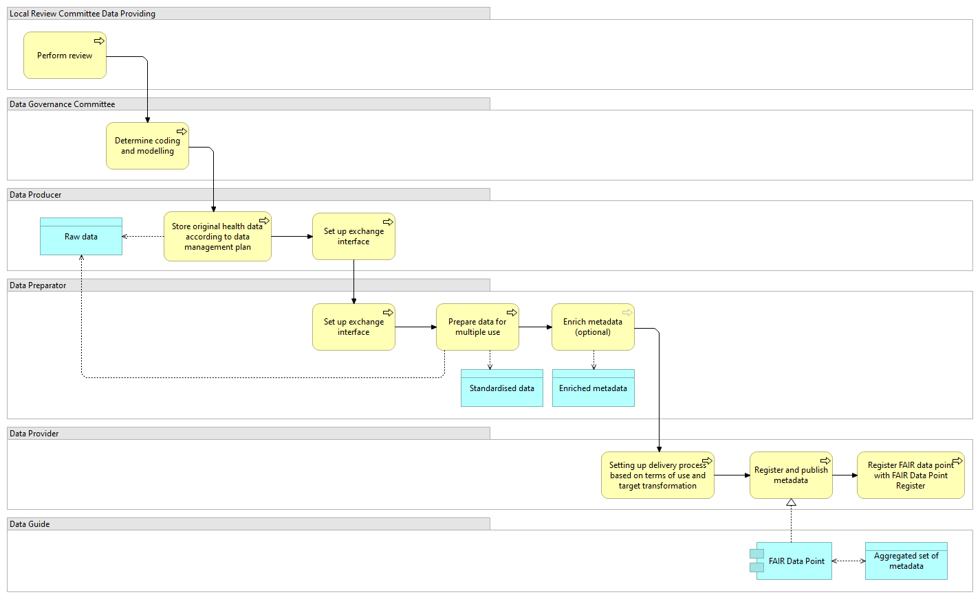
In the research data flow
Reference: https://health-ri.atlassian.net/wiki/spaces/WC/pages/179018198/Storyline+Making+data+available

Slide 16
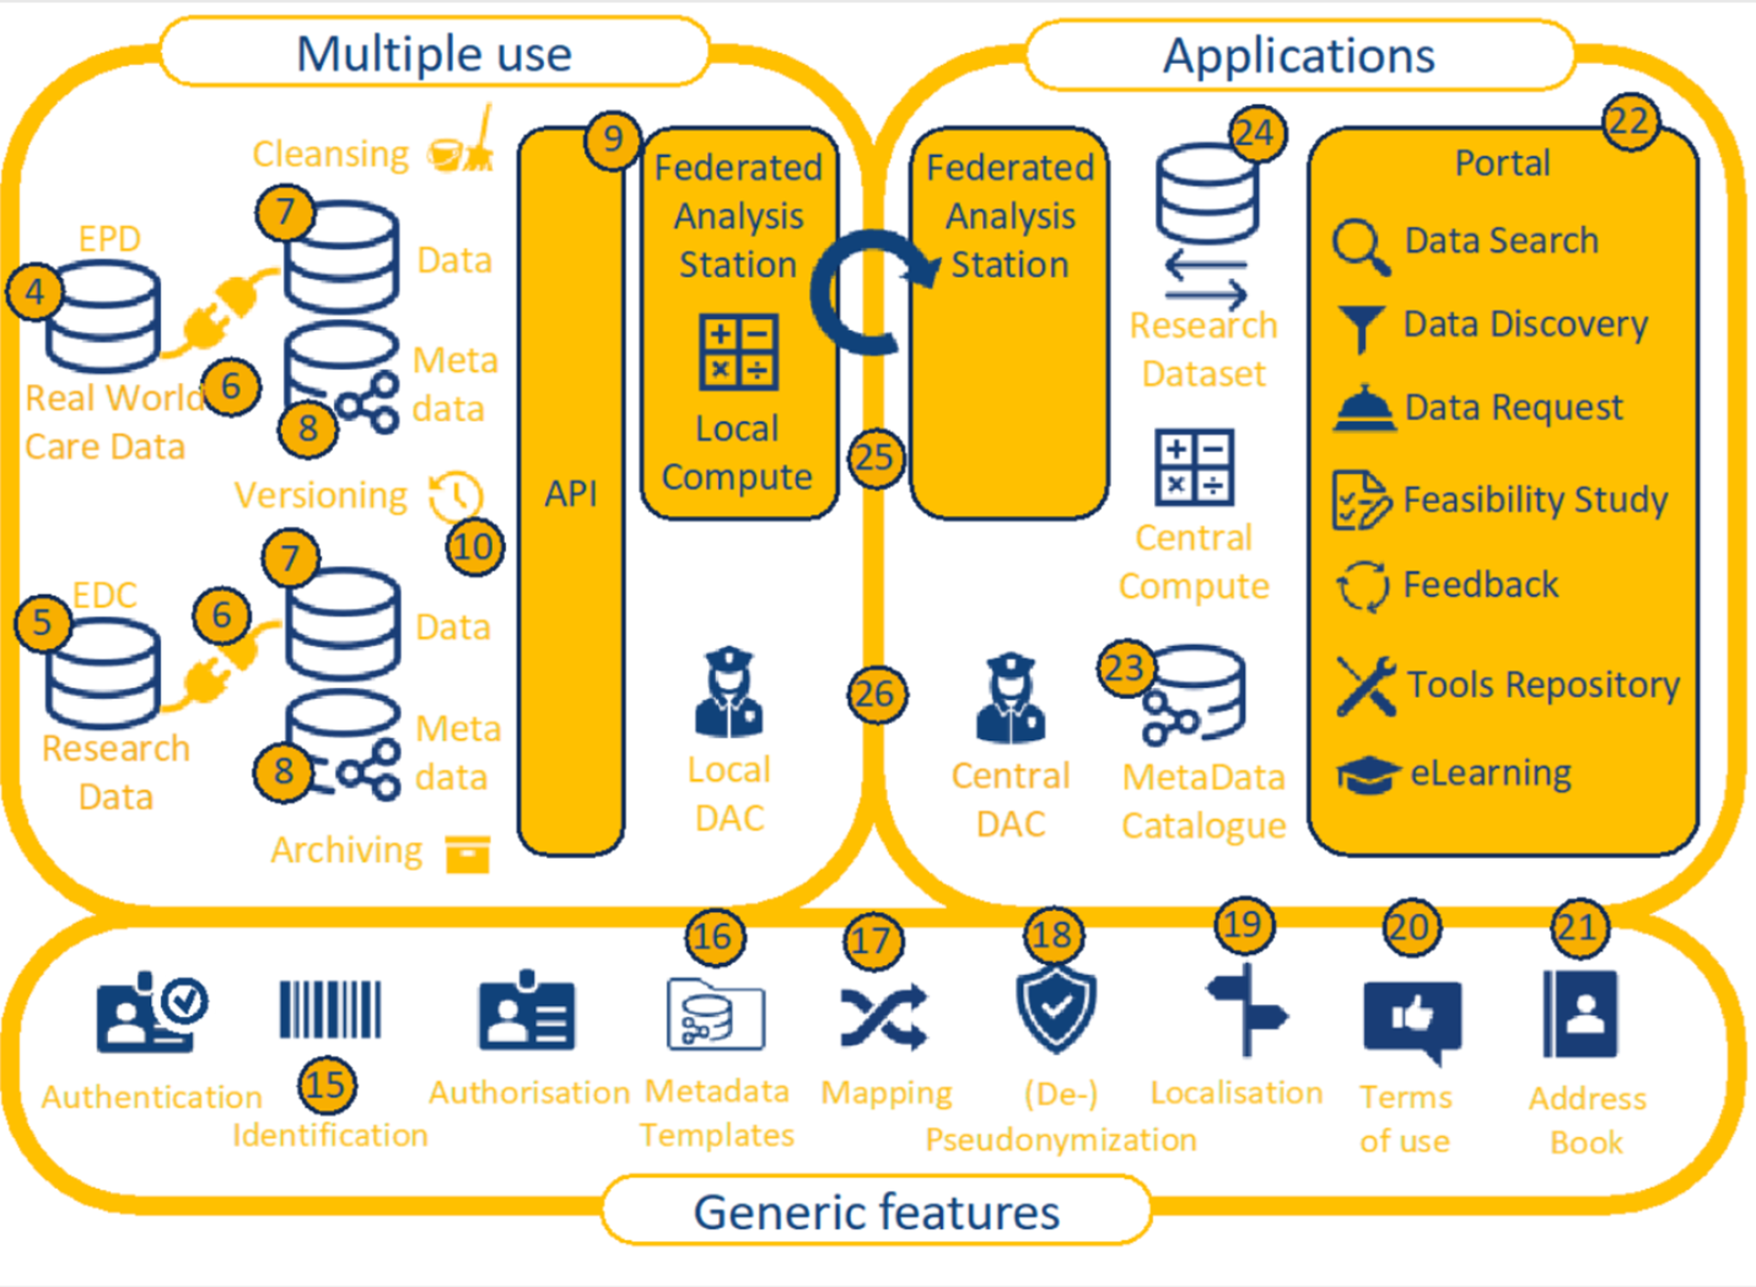
For Integration purposes
Reference:
https://health-ri.atlassian.net/wiki/spaces/WC/pages/179017015/Health+data+infrastructure+for+research+and+innovation
Notes:
https://health-ri.atlassian.net/wiki/spaces/WC/pages/179017015/Health+data+infrastructure+for+research+and+innovation

Slide 17
Presentations by Nodes

Slide 18
Biobanks& Collections working group
Presenter Rene → challenges with adopting the core model (Mapping and Transformation)

Slide 19
Radboud MC
Presenter Alex P --> (PRISMA usecase)
Presenter Pim → (VASCA usecase)

Slide 20
Imaging working group
Presenter Alexander --> Imaging domain specific metadata requirements

Slide 21
VUMC on ABC model
Presenter Joost Daams (on ABC model, requirements, and modelling approach)

Slide 22
Omics Woking group
No presenter

Slide 23
Clinical working group
No presenter

Slide 24
Break (15 min)

Slide 25
Collecting feedback on presentations
https://www.menti.com/al6mxu5gszyu
Go to menti.com and use the code to share your feedback
2498 6393

Slide 26
Evaluation Questionnaire

Slide 27
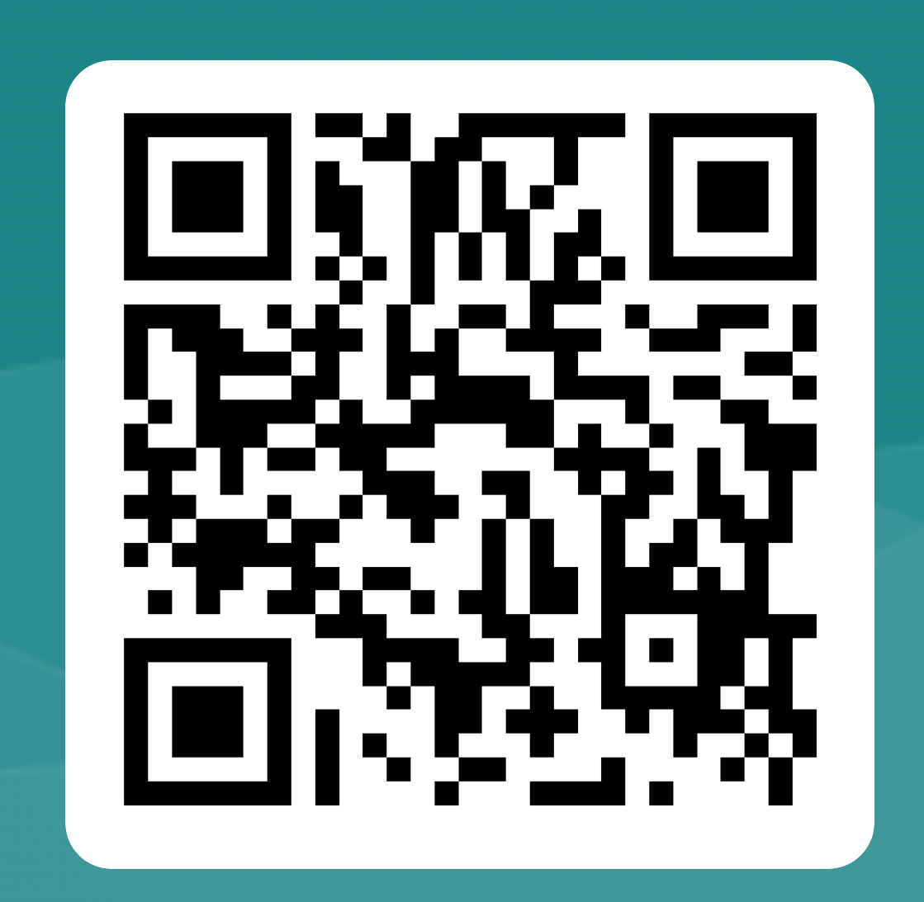
Evaluation Questionnaire
For evaluating the core concepts and their properties
Deadline (~ February ?)
Who should fill out the form?
Link to the form: https://forms.office.com/e/psAKZuRxfR

Slide 28
Next steps

Slide 29
NEXT STEPS
Incorporate the evaluation outcome
Extend the model with new requirements (in needed)
Get the endorsement of our community on the core model

Slide 30
Extensions to the Core model (V2)
Collect new requirements, competency questions
Extend the model with new concepts and properties
Research Resource
Registries
Scans
Data Service
request
access
Project, Study
Collect controlled vocabularies and taxonomies and link them to the core schema
Themes, Topic, Language, Licence
Get the endorsement of our community

Slide 31
2. Start with the Health metadata schema
Collect health specific requirements (for the Dutch health research)
Review the survey on the EU dcat health model and check how the model covers our requirements
https://ec.europa.eu/eusurvey/runner/ef70317f-e74d-f124-5928-6dc2837241ff

Slide 32
3. Domain specific modules
Imaging
Kick of session presentation
Requirements sheet
Omics
Kick of session presentation
Requirements sheet
Clinical
Kick of session presentation
Requirements sheet

Slide 33
Define modular Iimplementation of the models (collab with Implementation working group)
Modular implementation of the metadata schemas
Every module must have:
Representes a domain, or a specific functionality (core administrative, imaging, health, and so on.
Has a unique, persistent URIs as the Namespace
decodes in OWL, rdfs, Shape schema Language
Imports zero or many modules
Imports one or many community standards
DCAT, FOAF, Dcat-ap, HealthDcat, taxonomies

Slide 34
Challenges (process)
Working Groups (data and metadata teams)
Domain
Ownership
Roles of hubs and node
Community engagement
I suggest creating more open access webinars
We need to develop training materials
Capacity issues in the hub

Slide 35
Challenges (technical)
Toolings for our collaborative modelling
Use semantic web best practices in the design of the model
- pURIs for metadata instance and metadata elements
- Think ahead about modularisation
- Make reusable platforms/pipelines
- APIs,
- Queries
More collaboration between implementation team and metadata team

Slide 36
Discussions and collecting feedback
https://www.menti.com/alvwdrvfeear
Or go to menti.com and use the code The code 7431 4794
Notes:
TO DO

